Slide 1



Medical Inventory Optimization
Submitted by Team Member:
Name: Karan Ray
Email ID: karanrayz15@gmail.com
LinkedIn: linkedin.com/in/karan-ray-8a3342215

Slide 2
Contents
Business Objective
Business Constraints
Project Architecture - Data Flow Diagram
Data Collection
Exploratory Data Analysis
Data Visualization
Notes:
Change

Slide 3
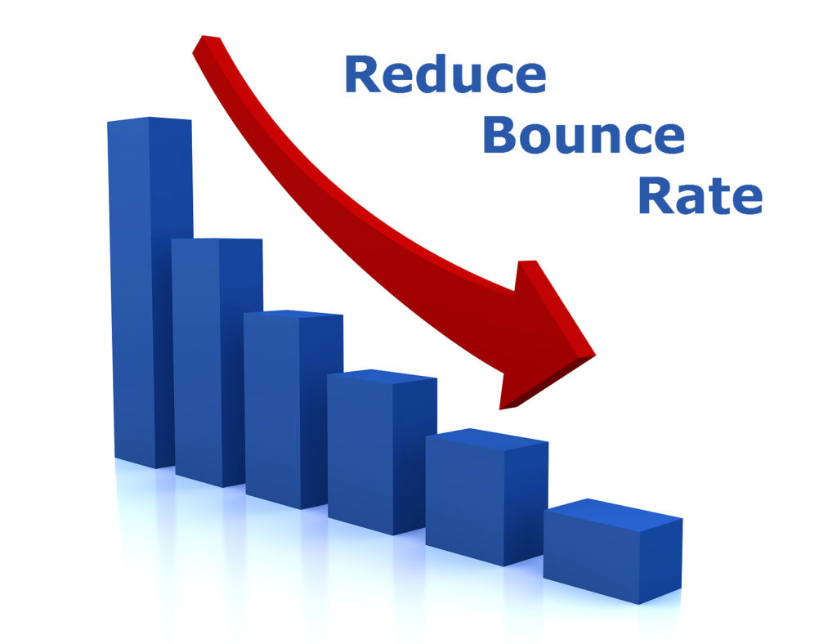

Business Problem
Bounce rate is increasing significantly leading to the patient dissatisfaction.
Business Objective
Business Constraint
Minimize Bounce Rate
Minimize Inventory Cost

Slide 4
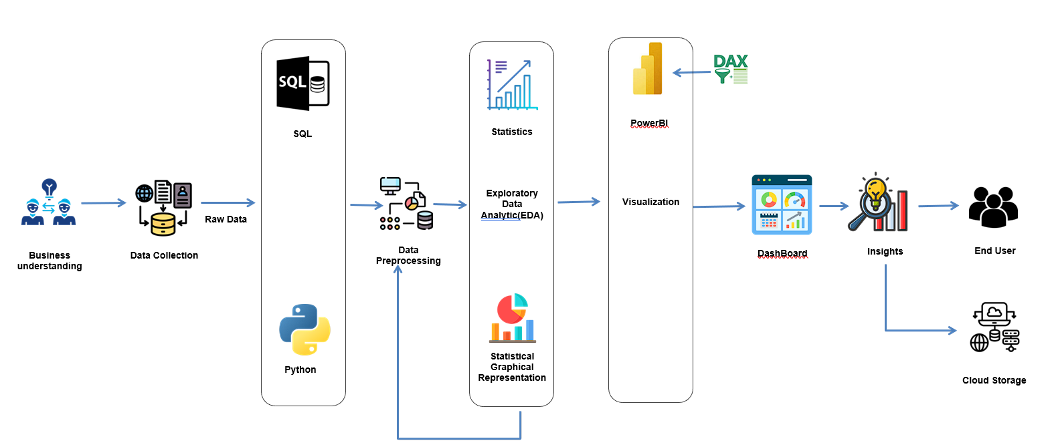
Project Overview and Scope

Slide 5
Data Dictionary
Sn. No | varialbe name | Variable Description | Data Type
1 | Typeofsales | Type of sale of the drug. Either the drug is sold or returned. | Categorical (String)
2 | Patient_ID | ID of a patient | Numeric
3 | Specialisation | Name of Specialisation (eg. Cardiology) | Categorical (String)
4 | Dept | Pharmacy, the formulation is related with. | Categorical (String)
5 | Dateofbill | Date of purchase of medicine | Date
6 | Quantity | Quantity of the drug | Numeric (Integer)
7 | ReturnQuantity | Quantity of drug returned by patient to the pharmacy | Numeric (Integer)
8 | Final_Cost | Final Cost of the drug (Quantity included) | Numeric (Float)
9 | Final_Sales | Final sales of drug | Numeric (Float)
10 | RtnMRP | MRP of returned drug (Quantity included) | Numeric (Float)
11 | Formulation | Type of formulation | Categorical (String)
12 | DrugName | Generic name of the drug | Categorical (String)
13 | SubCat | Subcategory (Type) to the category of drugs. | Categorical (String)
14 | SubCat1 | Subcategory (condition) to the category of drugs | Categorical (String)

Slide 6
Data Information
The dataset includes columns such as Patient_ID, Specialisation, Dept, Dateofbill, Quantity, ReturnQuantity, Final_Cost, Final_Sales, RtnMRP, Formulation, DrugName, SubCat, and SubCat1.
We are primarily focusing on the Quantity and ReturnQuantity columns, which serve as output variables. These columns provide information on the quantity of items sold and returned, crucial for assessing inventory turnover rates and identifying potential overstocking or understocking issues.
Additionally, the Final_Cost and Final_Sales columns represent the financial aspects of transactions, including costs and sales amounts. Analyzing these fields is fundamental for assessing profitability and revenue generation.
DrugName and SubCat fields help identify which drugs are being sold and their categories. This information is essential for understanding product popularity, market demand, and implementing effective inventory management strategies.

Slide 7
Exploratory Data Analysis [EDA]
Statistical Insights
Business Insights
Missing Values: Formulation (653 missing values), DrugName (1668 missing values), SubCat (1668 missing values), and SubCat1 (1692 missing values).
Look into the reasons behind lower sales months (February and June) to understand if there are any specific factors affecting demand.
Missing Value (%): Formulation (4.59), DrugName (11.73), SubCat (11.73), and SubCat1 (11.90).
Investigate the reasons behind high return rates in certain months.
Unique Values:
Formulation ('IV FLUIDS, ELECTROLYTES, TPN’, 'INJECTIONS’, 'TABLETS & CAPSULES’)
Subcat1 ('NUTRITIONAL SUPPLEMENTS', 'OINTMENTS, CREAMS & GELS', 'SPRAY', 'POWDER', 'TABLETS & CAPSULES’)
Focus on promoting high-selling drugname,subcat,subcat1 analyzing factors contributing to their success. Explore opportunities to expand sales channels or target new customer segments to increase overall sales.
Notes:
EDA is used for seeing what the data can tell us before the modeling task.
Change

Slide 8
Exploratory Data Analysis [EDA]
The medical_dataset comprises 14,218 records and includes essential columns such as Typeofsales, Patient_ID, Specialisation, Dept, Dateofbill, Quantity, ReturnQuantity, Final_Cost, Final_Sales, RtnMRP, Formulation, DrugName, SubCat, and SubCat1.
Descriptive statistics for numeric columns (Quantity, ReturnQuantity, Final_Cost, Final_Sales, RtnMRP) like mean, median, variance, standard deviation, range, skewness, and kurtosis provide insights into distribution and variability, aiding in inventory planning and risk assessment. Meanwhile, mode for categorical columns (Typeofsales, Specialisation, Dept, Formulation, DrugName, SubCat, SubCat1) offers insights into common types, specializations, formulations, and drug categories, guiding procurement and inventory categorization decisions.

Slide 9
Exploratory Data Analysis [EDA]
 | First moment Business Decision | Medical Inventory Optimization Dataset (Before cleaning) | Medical Inventory Optimization Dataset (After Cleaning)
Mean | Mean Quantity: | 2.232 | 1.870
 | MeanReturnQuantity: | 0.292 | 0.23841
 | Mean Final Cost: | 124.824 | 132.872
 | Mean Final Sales: | 234.038 | 229.888
 | Mean RtnMRP: | 29.127 | 28.496
Median | Median Quantity: | 1.000 | 1.0
 | Median Return Quantity: | 0.000 | 0.0
 | Median Final Cost: | 53.650 | 54.292
 | Median Final Sales: | 86.424 | 85.812
 | Median RtnMRP: | 0 | 0.0
Mode | Mode Type of Sales: | Sale | Sale
 | Mode Specialisation: | Specialisation4 | Specialisation4
 | Mode Department: | Department1 | Department1
 | Mode Formulation: | Form1 | Form1
 | Mode Drug Name: | SODIUM CHLORIDE IVF 100ML | SODIUM CHLORIDE IVF 100ML
 | Mode Subcategory: | INJECTIONS | INJECTIONS
 | Mode Subcategory 1: | INTRAVENOUS & OTHER STERILE SOLUTIONS | INTRAVENOUS & OTHER STERILE SOLUTIONS

Slide 10
Exploratory Data Analysis [EDA]
 | Second moment Business Decision | Medical Inventory Optimization Dataset (Before cleaning) | Medical Inventory Optimization Dataset (After Cleaning)
Variance | Variance Quantity: | 26.336 | 12.400
 | Variance Return Quantity: | 2.700 | 0.8165
 | Variance Final Cost: | 216007.852 | 243015.231
 | Variance Final Sales: | 450560.406 | 475084.668
 | Variance RtnMRP: | 33217.222 | 33075.686
Standard Deviation | Standard Deviation Quantity: | 5.132 | 3.521
 | Standard Deviation Return Quantity: | 1.643 | 0.903
 | Standard Deviation Final Cost: | 464.766 | 492.965
 | Standard Deviation Final Sales: | 671.238 | 689.263
 | Standard Deviation RtnMRP: | 182.256 | 181.867
Range | Range Quantity: | 150 | 150
 | Range Return Quantity: | 50 | 20
 | Range Final Cost: | 33138 | 33138.0
 | Range Final Sales: | 39490 | 39490.0
 | Range RtnMRP: | 8014 | 8014.0

Slide 11
Exploratory Data Analysis [EDA]
 | Third and Fourth moment Business Decision | Medical Inventory Optimization Dataset (Before cleaning) | Medical Inventory Optimization Dataset (After Cleaning)
Skewness | Skewness Quantity: | 11.34 | 17.077
 | Skewness Return Quantity: | 17.171 | 7.799
 | Skewness Final Cost: | 34.505 | 32.725
 | Skewness Final Sales: | 21.005 | 21.774
 | Skewness RtnMRP: | 15.796 | 16.826
Kurtosis | Kurtosis Quantity: | 180.09 | 463.540
 | Kurtosis Return Quantity: | 409.273 | 97.091
 | Kurtosis Final Cost: | 2025.154 | 1813.450
 | Kurtosis Final Sales: | 948.189 | 967.447
 | Kurtosis RtnMRP | 403.383 | 449.712

Slide 12
Exploratory Data Analysis [EDA]
Weekly and Monthly Insights:
Quantity:
Weekly quantity sold fluctuates, with Week 50 selling the highest at 653 units, while Week 0 had the lowest at 34. Monthly sales peak in December at 2426 units, followed closely by July and August. However, February and June saw lower sales at 1635 and 1614 units respectively, hinting at seasonal demand patterns.
Quantity return:
Week 5 had the highest returns, totaling 104 units, while Week 0 had the lowest returns, with only 2 units. In terms of months, August saw the highest returns at 329 units, whereas July had the lowest returns, with only 199 units.
Total quantity sold for each drug per week and month:
“SEVOFLURANE 99.97%” was the highest-selling drug, with 215 units sold in week 3, followed by 126 units in week 48, and 100 units in week 51.
In March, the drug “SEVOFLURANE 99.97%” had the highest sales, with 258 units sold.
Total sales per week and month:
The analysis reveals that December recorded the highest total sales, amounting to approximately 373536.002. Conversely, June had the lowest total sales, approximately 189623.272. In weekly terms, Week 52 saw the highest total sales of around 96458.51, while Week 0 had the lowest sales, around 3970.95.
Total final sales for each drug per week and month:
In month 12, 'HUMAN ALBUMIN 25% INJ' had the highest sales, approximately 42442.40. In Week 52, 'PEMBROLIZUMAB' led with approximately 39490 in sales.

Slide 13
Exploratory Data Analysis [EDA]
Bounce rate:
The bounce rate, calculated at 24.92%, indicates that nearly a quarter of customers who made purchases ended up returning items without any final sales. This suggests potential issues with product satisfaction, quality, or fulfillment processes that might be contributing to returns without purchases.
Drug Insights:
Drug with the highest total quantity sold:
The drug "Sodium Chloride IVF 100ML" stands out as the highest seller, totaling 1278 units sold.
Drug,subcat,subcat1 with the highest total sales quantity:
The combination of drug "SODIUM CHLORIDE IVF 100ML" with sub-categories "IV FLUIDS, ELECTROLYTES, TPN" and sub-category2 "INTRAVENOUS & OTHER STERILE SOLUTIONS" has the highest total quantity sold, amounting to 1278 units.
Number of drugs in each subcat,subcat1 that have been returned without making a sale:
The combination of sub-category "INJECTIONS" and sub-category2 "ANTI-INFECTIVES" has the highest count of returned drugs, with 32 distinct drugs being returned without making a sale (Final_Sales = 0). This indicates a potential issue with the effectiveness, quality, or demand for drugs within this category.

Slide 14
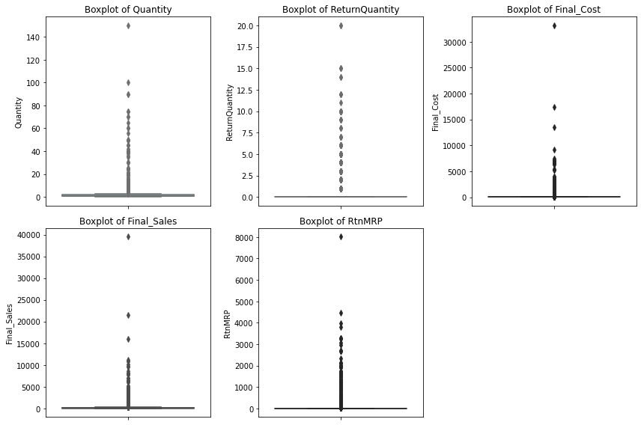
Exploratory Data Analysis [EDA]

Slide 15
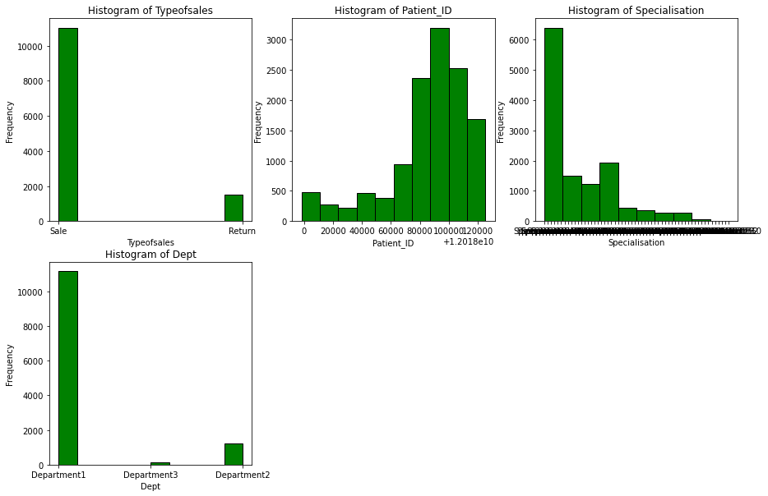
Exploratory Data Analysis [EDA]

Slide 16
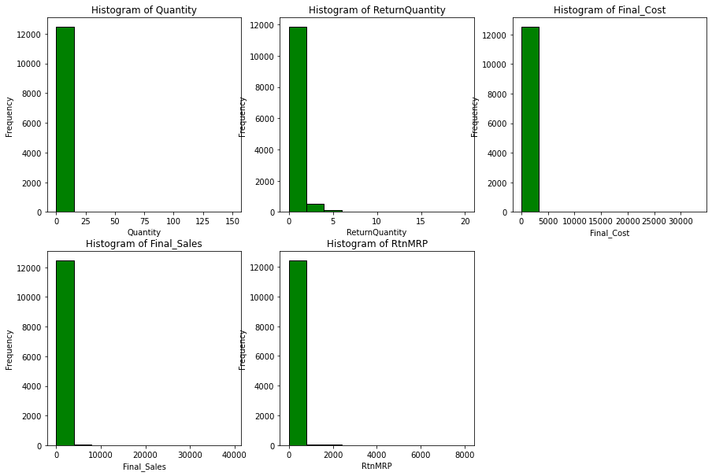
Exploratory Data Analysis [EDA]

Slide 17
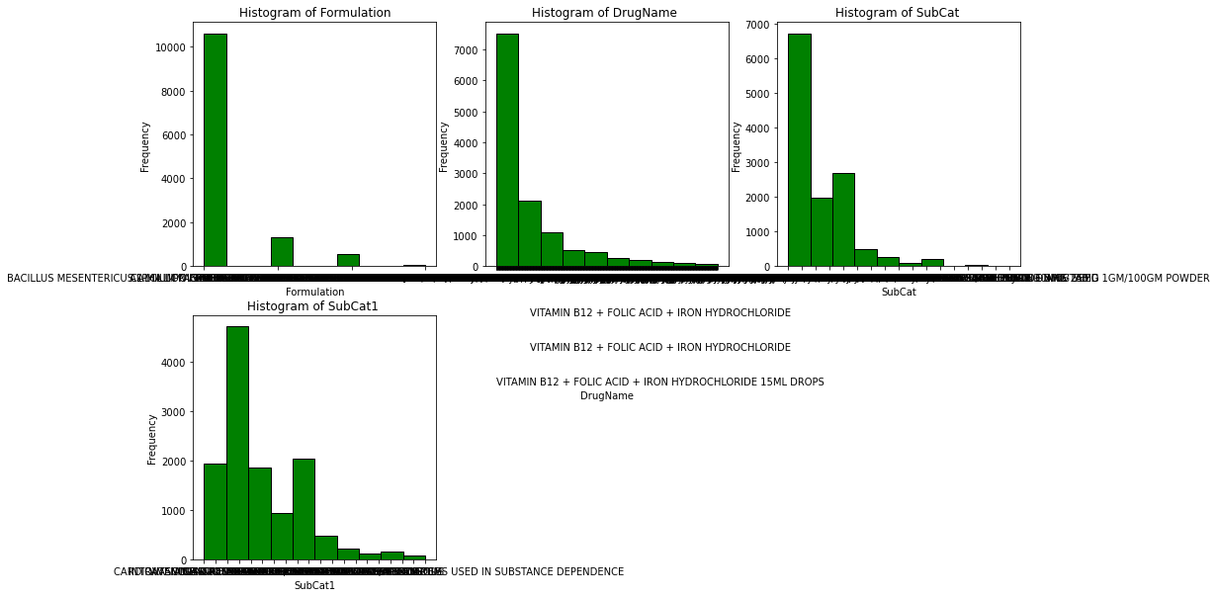
Exploratory Data Analysis [EDA]

Slide 18
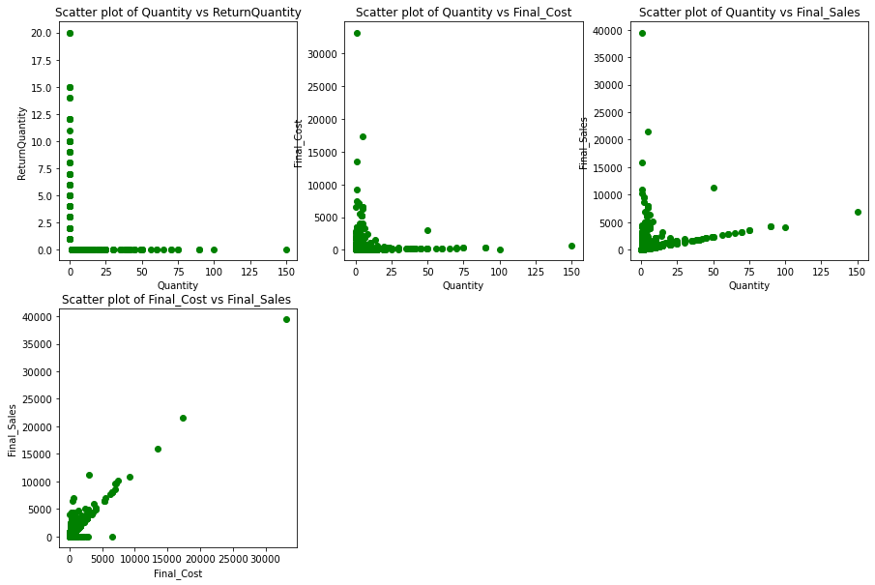
Exploratory Data Analysis [EDA]

Slide 19
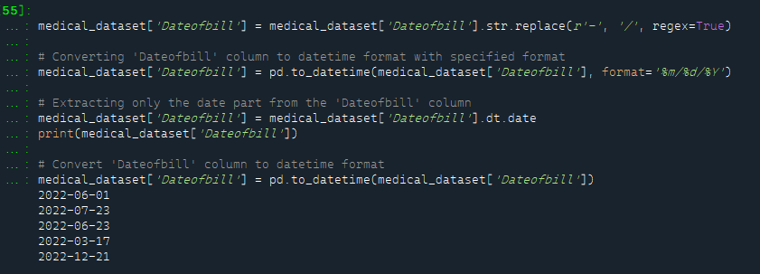
Data Preprocessing
Type Casting:
In the Medical Inventory Optimization Dataset, the 'dateofbill' column is not in the correct format; it should be in the date data type, but it is currently in the object data type. We need to convert the 'dateofbill' column from the object data type to the date data type.
Notes:
Keep observations

Slide 20
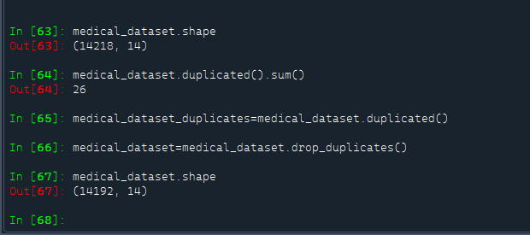
Data Preprocessing
Duplication Handling:
In the Medical Inventory Optimization Dataset, there are 26 duplicated records. We have removed these 26 duplicated records from the dataset.
After removing the duplicated records, the dataset contains 14,192 out of the original 14,218 records.

Slide 21
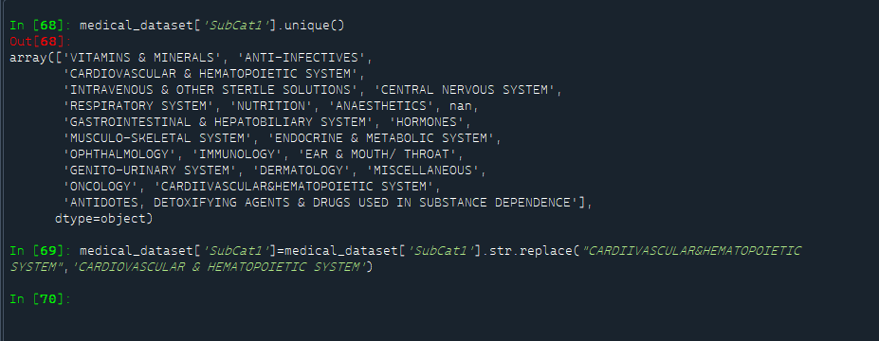
Data Preprocessing
Replacing Value:
In the Medical Inventory Optimization Dataset, we noticed that in the 'subcat1' column, two values appear to be the same but with differences in spacing. Specifically, 'CARDIOVASCULAR & HEMATOPOIETIC SYSTEM' and 'CARDIIVASCULAR&HEMATOPOIETIC SYSTEM' are equivalent. Therefore, we are replacing 'CARDIIVASCULAR&HEMATOPOIETIC SYSTEM' with 'CARDIOVASCULAR & HEMATOPOIETIC SYSTEM'.

Slide 22
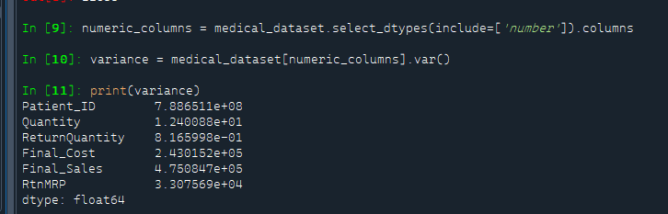
Data Preprocessing
Zero Variance:
In the Medical Inventory Optimization Dataset, there is no column with zero variance.

Slide 23
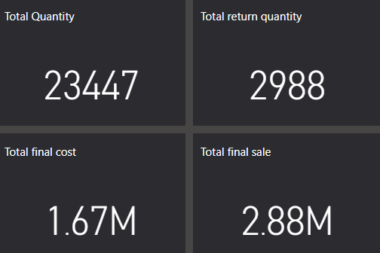
Data Visualization
Cards:
For the data visualization, we start by presenting the following Cards Which shows:
Total quantity( 23,447) ,Total return quantity( 2,988),Total final cost(1.67 million),Total final sale(2.88 million).
Notes:
Add graphical

Slide 24
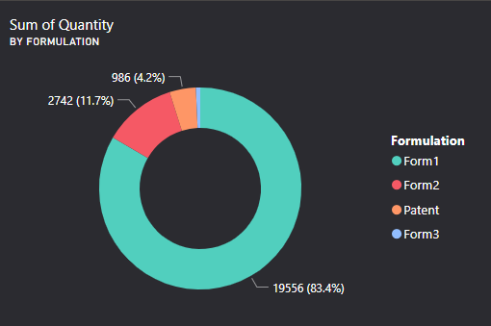
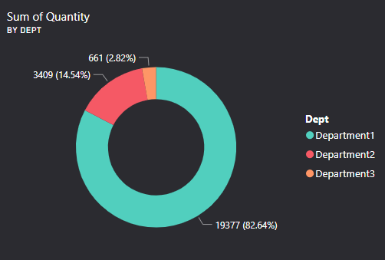
Data Visualization
Donut chart:
Two donut charts have been inserted: one displaying the sum of quantities by formulation, and the other showing the sum of quantities by department.

Slide 25
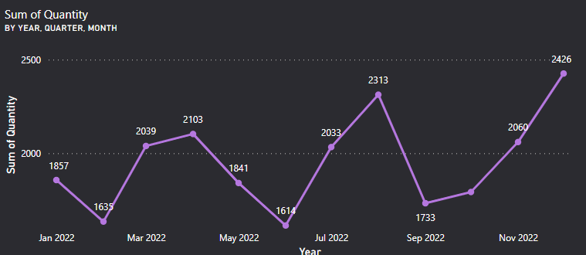
Data Visualization
Line chart:
A line chart is included to demonstrate the quantity sold per month, facilitating easy identification of the month with the highest quantity sold.

Slide 26
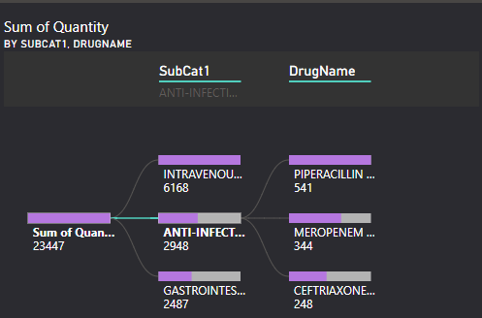
Data Visualization
Decomposition Tree:
The decomposition tree identifies the top contributors to the sum of quantity. By expanding the tree, we can see which ‘subcat1’ or ‘drugname’ are driving the highest quantities sold. This enables us to focus on the most influential factors.

Slide 27
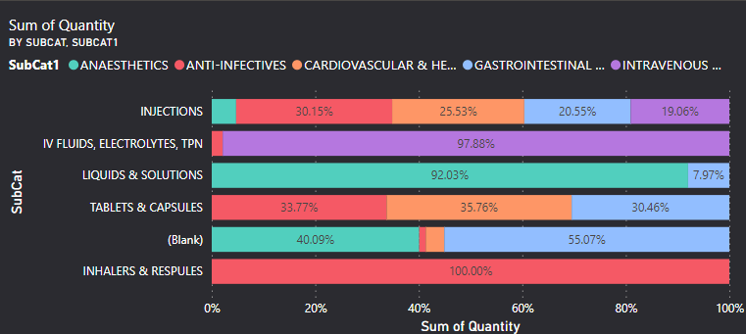
Data Visualization
100% Stacked Bar Chart:
This chart can visually represent the proportion of quantity contributed by each of the top 5 ‘subcat’ to the total quantity sold. and Within each of the top 5 ‘subcat’, the stacked bars can show the distribution of quantity among the top 5 ‘drugname’. This helps identify which drugs are the primary contributors to the quantity sold within each ‘subcat’.

Slide 28
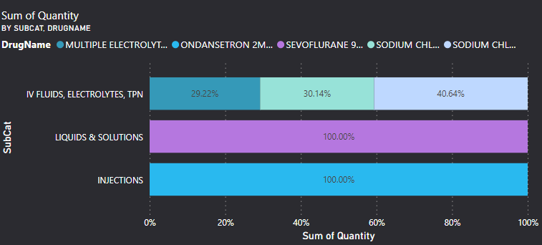
Data Visualization
This chart can visually represent the proportion of quantity contributed by each of the top 5 ‘subcat’ to the total quantity sold. and Within each of the top 5 ‘subcat’, the stacked bars can show the distribution of quantity among the top 5 ‘subcat1’. This helps identify which subcat1 are the primary contributors to the quantity sold within each ‘subcat’.

Slide 29


